Slide 1
Graphs
Course Code: 00090
Course Title: Discrete Mathematics
Dept. of Computer Science
Faculty of Science and Technology
Lecturer No: | 15 | Week No: | 9 | Semester:
Lecturer: | Name & email

Slide 2
Lecture Outline
Graphs and Graph Models (8.1)l
Multigraph
Pseudograph
Simple directed graph
Directed Multigraph
Mixed graph
Graph Terminology and Special Types of Graphs (8.2 )
Basic terminology
Adjacent vertices
Degree of a vertex
In-degree of a vertex
Out-degree of a vertex
Isolated vertex
Pendant vertex
The Handshaking Theorem
Some Special Simple Graphs
Bipartite Graphs

Slide 3
Objectives and Outcomes
Objectives: To understand basic terminologies of graph with examples, Handshaking theorem for undirected and directed graphs, some special types of graphs, bipartite graph and complete bipartite graph.
Outcomes: The students are expected to be able explain graph terminologies, be able to find out degree of vertices and prove Handshaking theorem, be able to draw Complete graph, Cycle, Wheel, n-cube, be able to determine whether a graph is bipartite using graph coloring.

Slide 4
Directed Graph
Definition 2: A directed graph(or digraph) (V,E) consists of a nonempty set of vertices V and a set of directed edges E.
Each directed edge is associated with an ordered pair of vertices.
The directed edge associated with the ordered pair (u,v) is said to start at u and end at v.

Slide 5
Graph Terminology : Different Types of Graphs
Simple Graph: An undirected graph with no multiple edges or loops is called a simple graph.
Multigraph: An undirected graph that may contain multiple edges connecting the same vertices but no loops.
Pseudograph: An undirected graph that may contain multiple edges and loops is called a pseudograph.

Slide 6
Graph Terminology : Different Types of Graphs
Simple Directed graph: When a directed graph has no loops and has no multiple directed edges, it is called a simple directed graph.
Directed multigraph: A graph with directed edges that may contain multiple directed edges is called a directed multigraph.
Mixed Graph: A graph with both directed and undirected edges is called a mixed graph. A mixed graph may contain loop(s).
Loop: An edge that connect a vertex to itself is called a loop.

Slide 7
Graph Terminology : Different Types of Graphs
Table 1: Graph Terminology
Type | Edges | Multiple Edges Allowed? | Loops Allowed?
Simple graph | Undirected | No | No
Multigraph | Undirected | Yes | No
Pseudograph | Undirected | Yes | Yes
Simple directed graph | Directed | No | No
Directed Multigraph | Directed | Yes | Yes
Mixed graph | Directed and Undirected | Yes | Yes

Slide 8
Graph Terminology and Special Types of Graphs (8.2)
Basic terminology
Adjacent vertices
Degree of a vertex
In-degree of a vertex
Out-degree of a vertex
Isolated vertex
Pendant vertex
The Handshaking Theorem
Some Special Simple Graphs
Bipartite Graphs

Slide 9
Basic Terminology
Definition1: Two vertices u and v in an undirected graph G are called adjacent (or neighbors) in G if u and v are endpoints of an edge of G.
If e is associated with {u, v}, the edge e is called incident with the vertices u and v.
The edge e is also said to connect u and v.
The vertices u and v are called endpoints of an edge associated with {u, v}.

Slide 10
Basic Terminology
Definition 3: The degree of a vertex in an undirected graph is the number of edges incident with it, except that a loop at a vertex contributes twice to the degree of that vertex.
The degree of the vertex v is denoted by deg(v)
Isolated vertex: A vertex of degree zero is called isolated.
Pendant vertex: A vertex is pendant if and only if it has degree one.

Slide 11
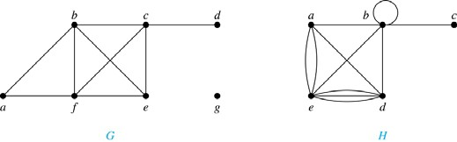
Example 1
Example 1 : What are the degrees of the vertices in the graphs G and H?
Solution:
G: deg(a) = 2, deg(b) = deg(c)= deg(f)=4, deg(d)=1, deg(e) = 3, and deg(g)= 0
H: deg(a) = 4, deg(b) = deg(e) = 6, deg(c) = 1, deg(d) = 5.

Slide 12
The Handshaking Theorem
Theorem 1 (The Handshaking Theorem):
Let G = (V,E) be an undirected graph with e edges. Then
2e =
deg(v)
Note: This applies even if multiple edges and loops are present

Slide 13
Example 2
Example 2: How many edges are there in a graph with 10 vertices each of degree six?
Solution: Because the sum of the degrees of the vertices is 6.10 = 60, it follows that 2e=60.
Therefore, e = 30

Slide 14
Theorem 2
Theorem 2: An undirected graph has an even number of vertices of odd degree.
Example: If a graph has 5 vertices, can each vertex have degree 3?
Solution: This is not possible by the Handshaking theorem, because the sum of the degrees of the vertices 3.5 = 15 is odd.

Slide 15
Initial vertex & Terminal Vertex
Definition 3: When (u, v) is an edge of the graph G with directed edges, u is said to be adjacent to v and v is said to be adjacent from u.
The vertex u is called the initial vertex of (u, v) and
v is called the terminal/end vertex of (u, v).
Note: The initial vertex and terminal vertex of a loop are the same.

Slide 16
In-degree & Out-degree of a vertex
Definition 4: In a graph with directed edges the
in-degree of a vertex v, denoted by deg–(v), is the number of edges with v as their terminal vertex.
The out-degree of v, denoted by deg⁺(v), is the number of edges with v as their initial vertex.
Note: A loop at a vertex contributes 1 to both the
in-degree and the out-degree of this vertex.

Slide 17
Example: In-degree & Out-degree of vertices of a graph
Question: What are in-degrees and out-degrees of all the vertices in the graph below?
2
1
3

Slide 18
Solution:
deg⁻(1) = 0
deg⁻(2) = 3
deg⁻(3) = 4
deg⁺(1) = 2
deg⁺(2) = 3
deg⁺(3) = 2
Practice Yourself: Example 4
2
1
3

Slide 19
Theorem 3
Theorem 3: Let G = ( V, E ) be a graph with directed edges. Then
➔ Handshaking Theorem for directed graph
deg–(v) =
deg⁺(v) = |E|

Slide 20
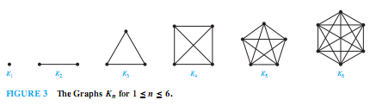
Some Special Simple Graphs: Complete Graph (K_{n} )
The complete graph on n vertices, denoted by K_{n}, is the simple graph that contains exactly one edge between each pair of distinct vertices.
The graph , for n = 1, 2, 3, 4, 5, 6 are displayed in the following figure:

Slide 21
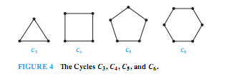
Some Special Simple Graphs: Cycles (C_{n})
The Cycle C_{n}, n>=3, consists of n vertices v₁, v₂, ….v_{n} and edges {v_{1 ,} v₂ }, {v₂, v₃}, …. {v_{n-1}, v_{n} }, and {v_{n}, v₁ }
The cycles for C₃ , C₄ , C₅ , and C₆ are displayed in the following figure:

Slide 22
Some Special Simple Graphs: Wheels (W_{n})
We obtain the Wheel (W_{n}) when we add an additional vertex to the Cycle C_{n} , for n>=3, and connect this new vertex to each of the n vertices in C_{n} , by new edges.
The wheel W_{n} is just a cycle graph with an extra vertex in the middle
The Wheels W₃ , W₄ , W₅ are displayed in the figure below:

Slide 23
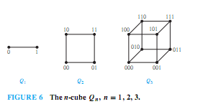
Some Special Simple Graphs: n-Cubes(Q_{n})
The n-dimensional hypercube, or n-cube, denoted by Q_{n}, is the graph that has vertices representing the 2^{n} bit strings of length n.
Two vertices are adjacent iff the bit strings that they represent differ in exactly one bit position.
The graphs Q₁, Q₂ , and Q₃are displayed in the following figure:

Slide 24
Bipartite graphs
Definition 5: A simple graph G is called bipartite if its vertex set V can be partitioned into two disjoint sets V₁ and V₂ such that every edge in the graph connects a vertex in V₁ and a vertex in V₂
Note: If each vertex of V₁ is connected to each vertex of V₂, then it is called complete bipartite graph and it is denoted by K_{m,n} where m is the number of vertices in V₁ and n is the number of vertices in V₂

Slide 25
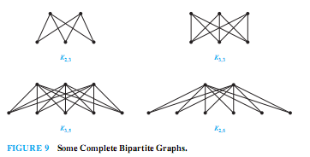
Examples of Complete Bipartite graphs

Slide 26
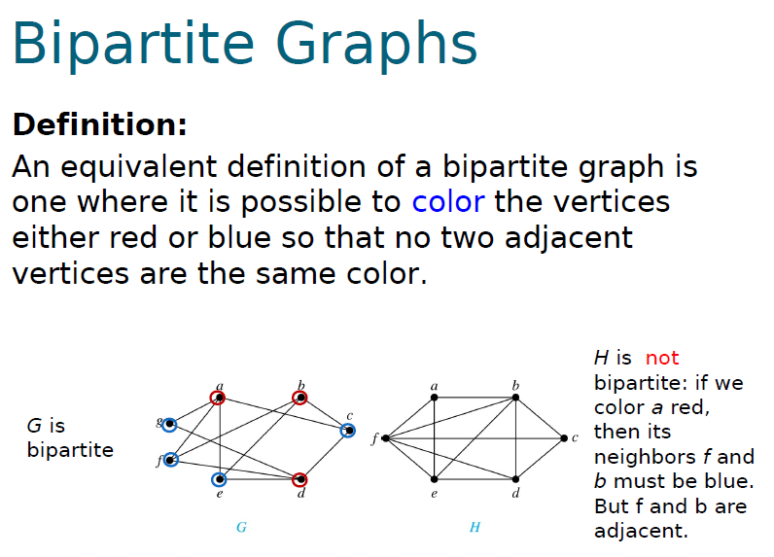
Example 11: Are the graphs G and H are Bipartite?

Slide 27
Practice @ Home
Relevant Odd-Numbered exercises from text book

Slide 28
Books
Rosen, K. H., & Krithivasan, K. (2012). Discrete mathematics and its applications: with combinatorics and graph theory. Tata McGraw-Hill Education. (7th Edition)
Liu, C. L. (1986). Elements of discrete mathematics. Tata McGraw-Hill Education.

Slide 29
References
Discrete Mathematics, Richard Johnsonbaugh, Pearson education, Inc.
Discrete Mathematical Structures, Bernard Kolman, Robert C. Busby, Sharon Ross, Prentice-Hall, Inc.
SCHAUM’S outlines Discrete Mathematics(2nd edition), by Seymour Lipschutz, Marc Lipson
Deo, N. (2017). Graph theory with applications to engineering and computer science. Courier Dover Publications.
Radford University Lecture: https://www.radford.edu/~nokie/classes/360/graphs-terms.html

